Slide 1
WALK WISE: A MACHINE LEARNING EXPLORATION OF
URBAN WALKABILITY
Group – 5
Vaibhavi, Akhil, Taruni, Laila, Santoshi Nikitha

Slide 2
Introduction
Walkability refers to how friendly an area is to walking. Factors influencing walkability include but are not limited to, the presence of footpaths, pedestrian rights, traffic, road conditions, and safety.
Impact on Urban Areas: Improves health, reduces car dependency, enhances social interaction, and boosts local economies.
Study Focus: Analysis of urban walkability using machine learning and neural networking to predict and improve pedestrian movement patterns in urban settings.
Hypothesis!
Enhance urban design, promote sustainable transportation, and foster pedestrian-friendly environments by analyzing various urban factors.

Slide 3
Research Questions
1
How does neighborhood walkability correlate with job- housing balance?
2
What impact does combining retail, office, and residential land use have on walkability scores?
Is there a correlation between demographics, such as auto ownership rates, and walkability?
3
Can traffic measures predict areas with high walkability?
4
5
How do employment variables influence neighborhood walk scores?

Slide 4
Literature Review
Paper Name | Key Findings | Limitations
Exploring deep network approximations using diverse activation functions beyond ReLU, including ELU and GELU | Demonstrates that ReLU network results extend to networks using alternative activation functions, maintaining approximation capabilities. | Further research is needed to optimize scaling factors for width and depth and validate against more empirical data.
Semi-supervised and unsupervised sense annotation via translations. Proceedings of the Conference Recent Advances in Natural Language Processing Hauer, B. K. (2021) | The introduced methods utilize machine translation, parallel bitexts, and lexical resources to achieve state-of-the-art results in standard WSD benchmarks, improving the performance of supervised WSD systems without extensive manual annotation. | While the methods show promising results, the dependence on the quality and availability of parallel corpora and machine translation may limit their effectiveness in less-resourced languages or specialized domains.
Using deep neural networks coupled with principal component analysis for ore production forecasting at open-pit mines, Fan, C., Zhang, N., Jiang, B., & Liu, W. V. (2024) | It finds RSM to provide slightly better accuracy than ANN in predicting the compressive and splitting tensile strength of the concrete. | The limitations are not explicitly detailed in the given excerpt, but it's suggested that the generalizability of the findings might be restricted to the specific types of waste materials and the experimental conditions used.

Slide 5
Research Methods Overview
Dataset Evaluation
Predictive Modeling
Analytical Techniques
Application of machine learning models to predict and analyze pedestrian movement patterns in urban settings, enhancing urban planning decisions.
Utilization of a comprehensive dataset from Data.gov covering diverse urban factors, ensuring geographic representation across various urban areas.
Includes data preprocessing, exploratory data analysis (EDA), feature engineering using PCA, and model selection and training focusing on linear regression and neural networks.

Slide 6
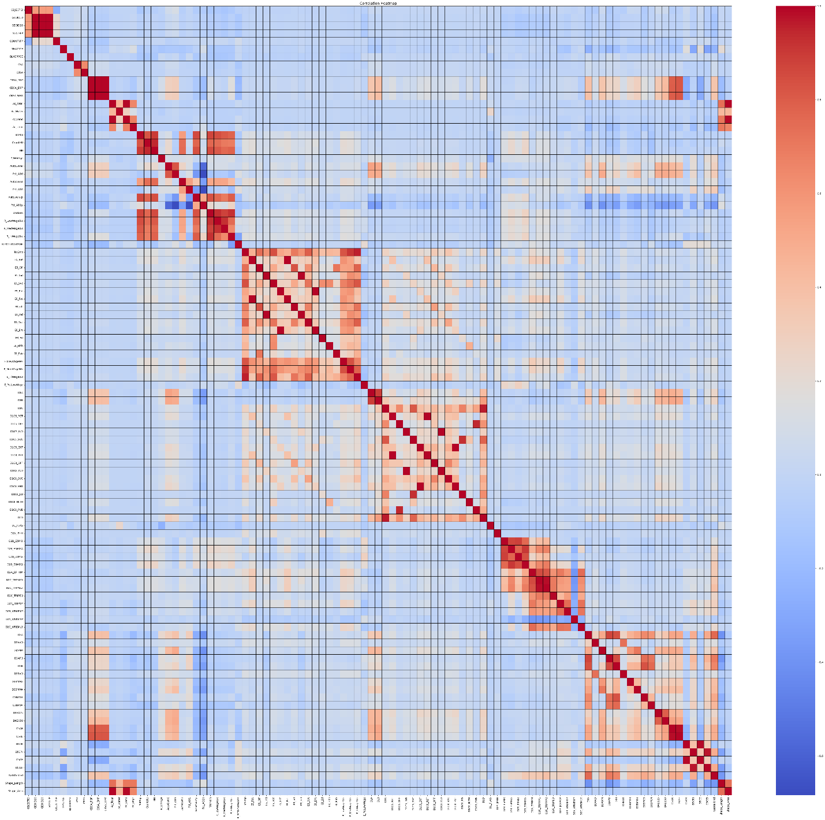
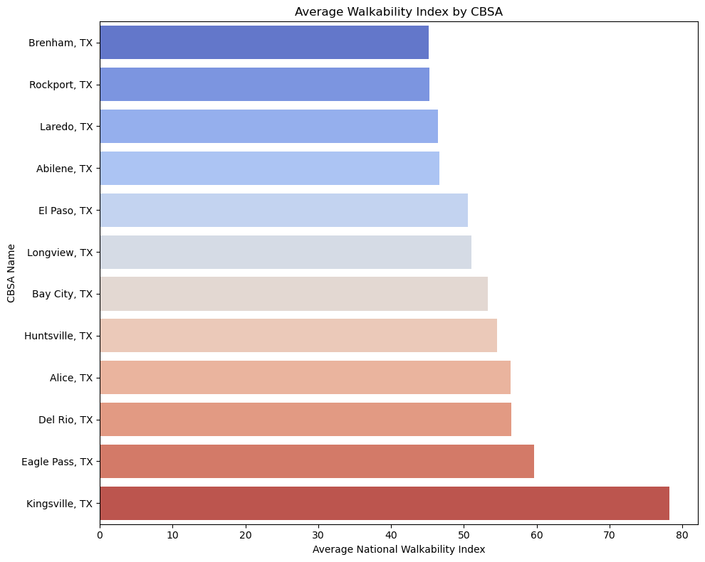
Data Analysis Techniques
Correlation Analysis
Descriptive Statistics:
Explores relationships among variables to identify patterns and trends, crucial for developing predictive models.
Visualization Techniques
Utilization of scatter plots, heatmaps, and other graphical representations to make data analysis results accessible and understandable.
Provides insights into the size, structure, and distribution of data, using measures such as mean, standard deviation, and percentiles.

Slide 7
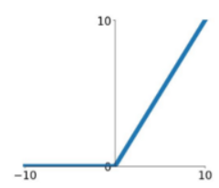
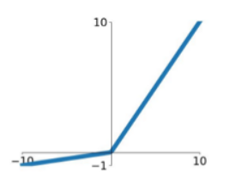
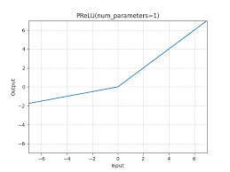
Activation Functions in Neural Networks
ReLU (Rectified Linear Unit)
ReLU is defined as the positive part of its argument. It outputs the input directly if it is positive, otherwise, it will output zero.
Variants of ReLU
Includes LeakyReLU, which allows a small, positive slope when the input is negative, and PReLU (Parametric ReLU), where the slope is learned during training.
Application in Models
These activation functions are popular in neural networks for their efficiency in training and ability to mitigate the vanishing gradient problem.

Slide 8
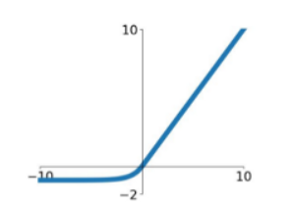
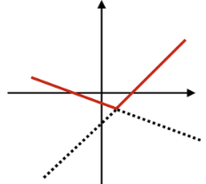
Activation Functions in Neural Networks
ELU (Exponential Linear Unit)
ELU helps reduce the vanishing gradient effect. Outputs an exponential decay towards negative infinity when the input is negative and the identity when the input is positive.
Maxout
Includes LeakyReLU, which allows a small, positive slope when the input is negative, and PReLU (Parametric ReLU), where the slope is learned during training.
Benefits of Deep Learning
Both ELU and Maxout provide improved learning characteristics over other activation functions, including faster convergence and better handling of non-linearities.

Slide 9
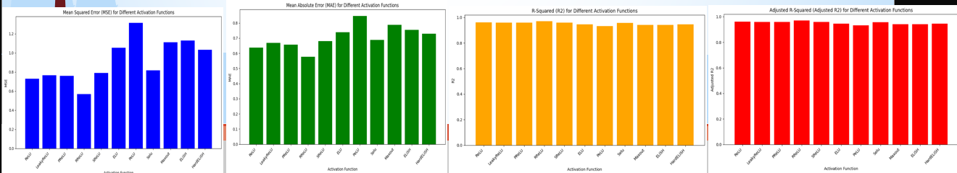
Comparative Results of Activation Functions
Performance Metrics
Effectiveness of Functions
Model Adaptability
Analysis based on Mean Squared Error (MSE), Mean Absolute Error (MAE), and R-squared values across different activation functions.
Highlights the effectiveness of RReLU showing lower MSE and higher R2, indicating better predictive accuracy and reliability.
Discussion on how activation function choice impacts model training dynamics and generalization ability in varying contexts.

Slide 10
Conclusion and Future Work
Invest in Public Transit
Future Research Directions
Impact on Urban Planning
Recommend investment in robust public transit systems to reduce reliance on automobiles, which enhances urban walkability and accessibility.
Future studies should integrate ArcGIS REST API data and use advanced deep learning techniques to enhance urban planning accuracy.
Results provide actionable insights that can guide urban development, improve pedestrian safety, and enhance overall community livability.
Key Findings
Future Implications
The study successfully demonstrated the application of machine learning to predict urban walkability, highlighting significant factors influencing pedestrian environments.
The findings underscore the importance of data-driven approaches in urban planning to create more sustainable and efficient urban environments.

Slide 11
Thank You !

